Slide 1
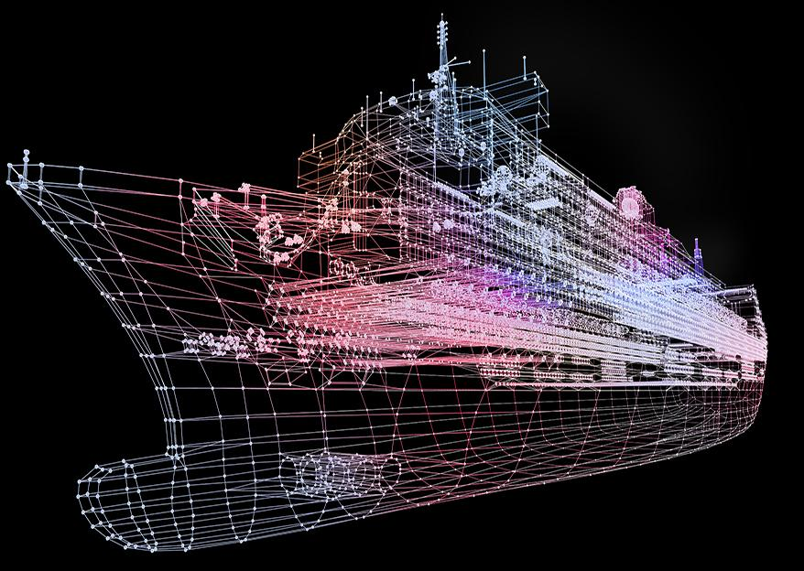
SHIP CLASSIFICATION USING TRIPLET CNN
Guided by,
Submitted by,
ABIN K JAYAN ADR18CS001
AJMAL LATHEEF ADR18CS003
ASHIL JOHNSON ADR18CS014
SIDDHARDH R NAIR ADR18CS038
Mrs. Manju J
Assistant Professor
Dept. of Computer Science

Slide 2
CONTENTS
AIM
INTRODUCTION
EXISTING SYSTEM
DRAWBACKS
PROPOSED SYSTEM
DATA FLOW DIAGRAM
MODULES
Dataset creation
Triplet sampling
Architecture creation
Training using triplets and saving model
Prediction
GRAPHICAL USER INTERFACE
ADVANTAGES
FUTURE SCOPE
SYSTEM SPECIFICATION
CONCLUSION
REFERENCES

Slide 3
AIM
To develop Ship classification from SAR images using special Triplet deep learning model

Slide 4
INTRODUCTION
The purpose of ship classification is to identify various types of ships as accurately as possible, which is of great significance for monitoring the rights and interests of maritime traffic and improving coastal defense early warnings.
With the improvement of all kinds of imaging technology, the ship classification method of imaging technology has become the mainstream method of ship target classification and recognition.

Slide 5
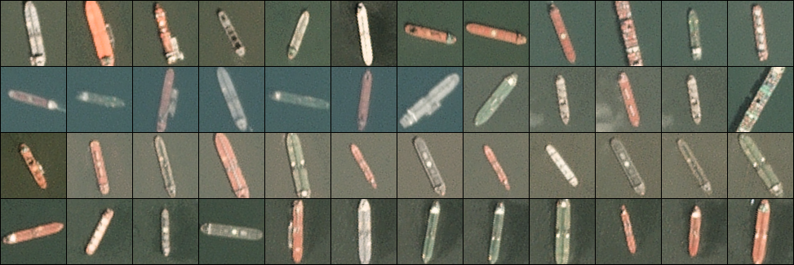
FIVE TYPES OF SHIPS

Slide 6
EXISTING SYSTEM
Y. Wang and H. Liu, “A hierarchical ship detection scheme for highresolution SAR images,” IEEE Trans. Geosci. Remote Sens., vol. 50, no. 10, pp. 4173–4184, Oct. 2012
The existing system classify ships from normal images using normal CNN.

Slide 7
DRAWBACKS
The existing system has low accuracy.
It was only able to predict ship type from normal images.
It cannot predict ship type from a satellite image.

Slide 8
PROPOSED SYSTEM
“Ship Classification in Medium-Resolution SAR Images via Densely Connected Triplet CNNs Integrating Fisher Discrimination Regularized Metric Learning” Jinglu He, Yinghua Wang ,Hongwei Liu
Use tripplet CNN for classifying ship from satellite image.

Slide 9
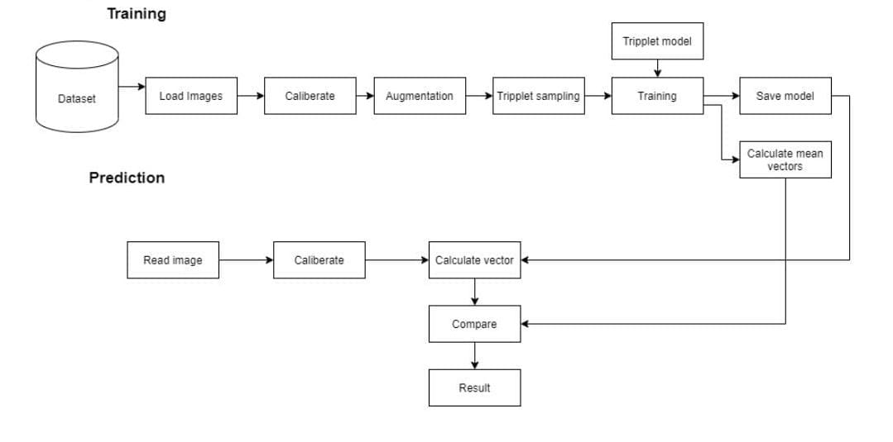
DATA FLOW DIAGRAM

Slide 10
MODULES
Dataset creation
Tripplet sampling
Architechure creation
Training using tripplets and saving model
Prediction

Slide 11
DATASET CREATION
OpenSARShip is the dataset used.
Calibrate all images using python
Edges of the images are sharpened.
Data augmentation
Horizontally and vertically flip the ship chips.
Randomly translate the ship chips with the translation .
Rotate the ship chips by 90◦, 180◦, and 270°.

Slide 12
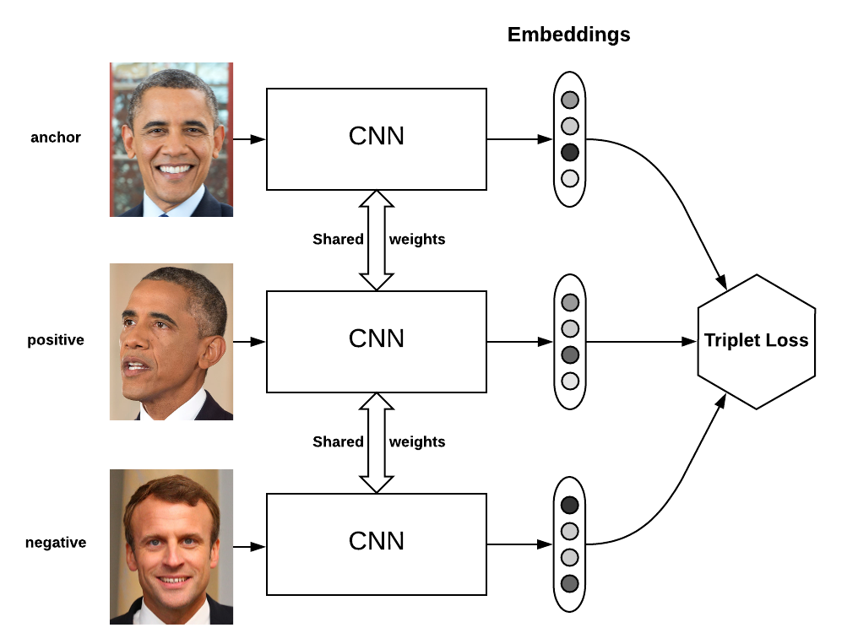
TRIPLET SAMPLING
A triplet, comprising an anchor image (x_{a}), a positive image(x_{p})from the same class as the anchor and a negative image (x_{n}) from another class, is mapped to a d-dimensional.
In the embedding space, the triplets should satisfy the following distance constraint: D(x_{a},x_{p})+α < D(x_{a}, x_{n}) ∀(x_{a}, x_{p}, x_{n})
The Euclidean distance, e.g., between the positive pair (x_{a}, x_{p}) in the feature space, can be computed as follows: D(x_{a}, x_{p}) = ||f(x_{a}) − f(x_{p})||².

Slide 13
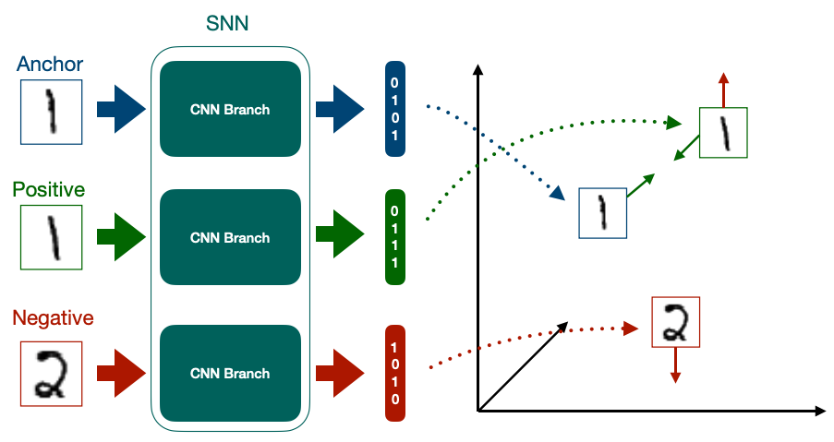
ARCHITECTURE CREATION
CNN consist of different layers:
Convolutional layer
Batch normalization layer
Pooling layer

Slide 14
TRAINING AND SAVING MODEL
Triplet CNN algorithm is used to train the dataset
Input image is entered into the 3 CNN layers
Feature extraction is done in the layers
In each training the distance between anchor image and positive image is reduced and distance between anchor image and negative is increased.
Thus the final vector is formed for each classification.

Slide 15
PREDICTION
satellite image is read as input
Input image is calibrated
Calculation of vector
Comparing the vectors
The vector with minimum Euclidian distance is considered as the resultant ship classification

Slide 16
GRAPHICAL USER INTERFACE
GUI will be created in tkinter
GUI will contain an option for insertion of SAR Image
GUI will have an option to see result of prediction (Ship type)

Slide 17
ADVANTAGES
This system is more accurate than existing systems.
It has a capability of predicting ship type from satellite image
It can classify four different types of ships

Slide 18
FUTURE SCOPE
In the future there will be more advanced military operations.
The machine learning based satellite image classification holds a huge scope.
It can be used for rescue operations.
It can be used for finding lost ship in the sea.

Slide 19
SYSTEM SPECIFICATIONS
Hardware Specification
Processor: i3
RAM: 8GB
Hard Disk: 500GB or above
Software Specification
Tool: Sublime text, Anaconda, tkinter
Language: Python
Operating System: Windows 7 or later

Slide 20
CONCLUSION
The existing system classify ships from normal images using normal CNN
The proposed system improved ship classification by introducing special Triplet deep learning model.

Slide 21
REFERENCE
A. Moreira, P. Prats-Iraola, M. Younis, G. Krieger, I. Hajnsek, and K. P. Papathanassiou, “A tutorial on synthetic aperture radar,” IEEE Geosci. Remote Sens. Mag., vol. 1, no. 1, pp. 6–43, Mar. 2013.
K. El-Darymli, E. W. Gill, P. Mcguire, D. Power, and C. Moloney, “Automatic target recognition in synthetic aperture radar imagery: A state-ofthe-art review,” IEEE Access, vol. 4, pp. 6014–6058, 2016.
X. X. Zhu et al., “Deep learning in remote sensing: A comprehensive review and list of resources,” IEEE Geosci. Remote Sens. Mag., vol. 5, no. 4, pp. 8–36, Dec. 2017.
D. J. Crisp, “The state-of-the-art in ship detection in synthetic aperture radar imagery,” DSTO Inf. Sci. Lab., Edinburgh, SA, Australia, Tech. Rep. DSTO-RR-0272, 2004.
G. Di Martino, A. Iodice, D. Riccio, and G. Ruello, “Ocean monitoring with SAR: An overview,” in Proc. OCEANS, May 2015, pp. 1–5

Slide 22
THANK YOU

Slide 23
SAR
The medium to high resolution and wide coverage imaging ability of Synthetic Aperture Radar (SAR) systems are developed for intelligent maritime surveillance, especially for ship classification in SAR images
SAR is independent of flight altitude, whether, and has day and night imaging capability
Applications of SAR are numerous. Examples include topography, oceanography, glaciology, geology. SAR can also be applied for monitoring civil infrastructure stability such as bridges and also beused in environment monitoring such as oil spills, flooding, urban growth, military surveillance.

